Slide 1

ONENESS POEM

Slide 2




The fear, the failure, the fatigue and frustration
The feeling of loneliness, the loss of sensation.
Self-doubt, self-hatred, self-denial too,
How the hell can I be You?

Slide 3
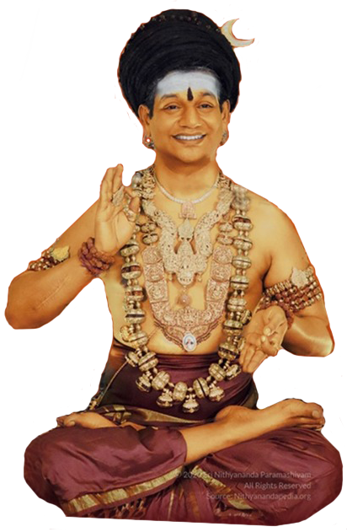
What I do, I do for you
Though you may not feel it, I truly care about you
Have trust, have courage, be patient and true
For You are I and I am You

Slide 4
I have pain that has rocked my very being
Breaking me into pieces without me even knowing
Cutting me, tearing me, caged in like the zoo,
Free me from here if what you say is the truth.

Slide 5
Listen blessed one, now I will reveal to you
I’m the Whole, the Completion that is the truth
You’re a part of Me so I feel everything you do
For You are I and I am You

Slide 6
So all this time You’ve just ignored what I’ve said
Did not even listen and left me for dead
One sentence, one word You could have shared about You
So much earlier I could have felt that maybe I was like You

Slide 7
I listen, I hear, I respond to your questions
It might not be direct, it might be only through mentions
But do you listen to yourself because that is when I speak to you
For You are I and I am you

Slide 8
The shackles of negativity which is holding me down
To be free from that, be light, turn my life around
To be blissful, joyous, please share what I must do
What I must do to know that I'm You.

Slide 9
Complete with your past and be in the present
Have total awareness, let go of resentment
Have confidence, have strength, be sure about you
For You are I and I am You

Slide 10
All the pain all the suffering all that I went through
Could I not have gone through this and still have felt you
Why did you let me experience all this
I felt like dying, having death’s kiss.

Slide 11
What I do, I do to show you
Show what you are not, and to show you the truth
Until now you have not felt that I was you
And now that you know experience the Truth

Slide 12
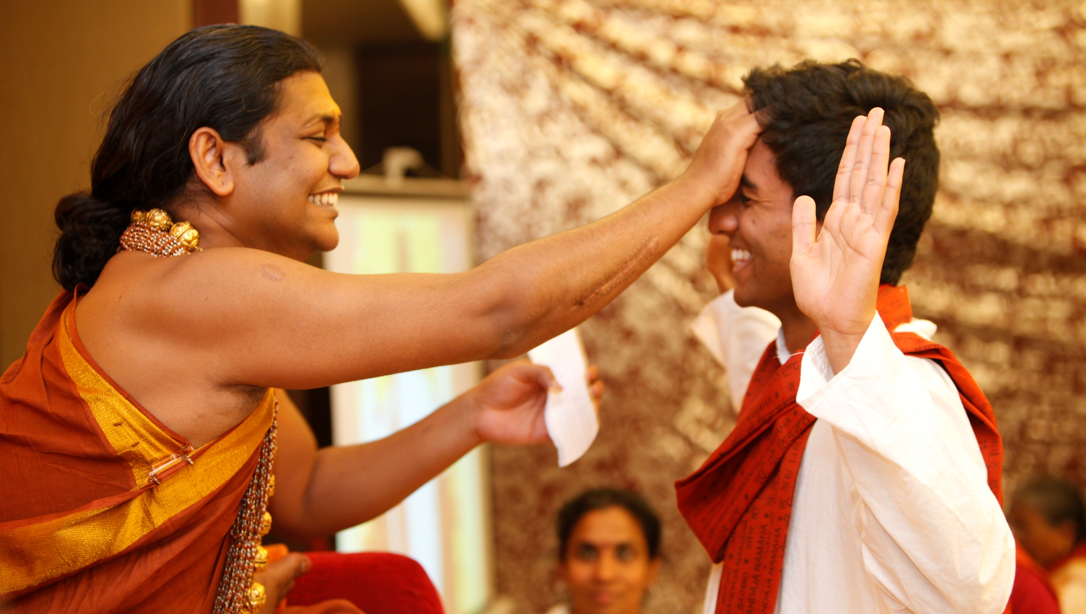
#WhoAmI?

Slide 13
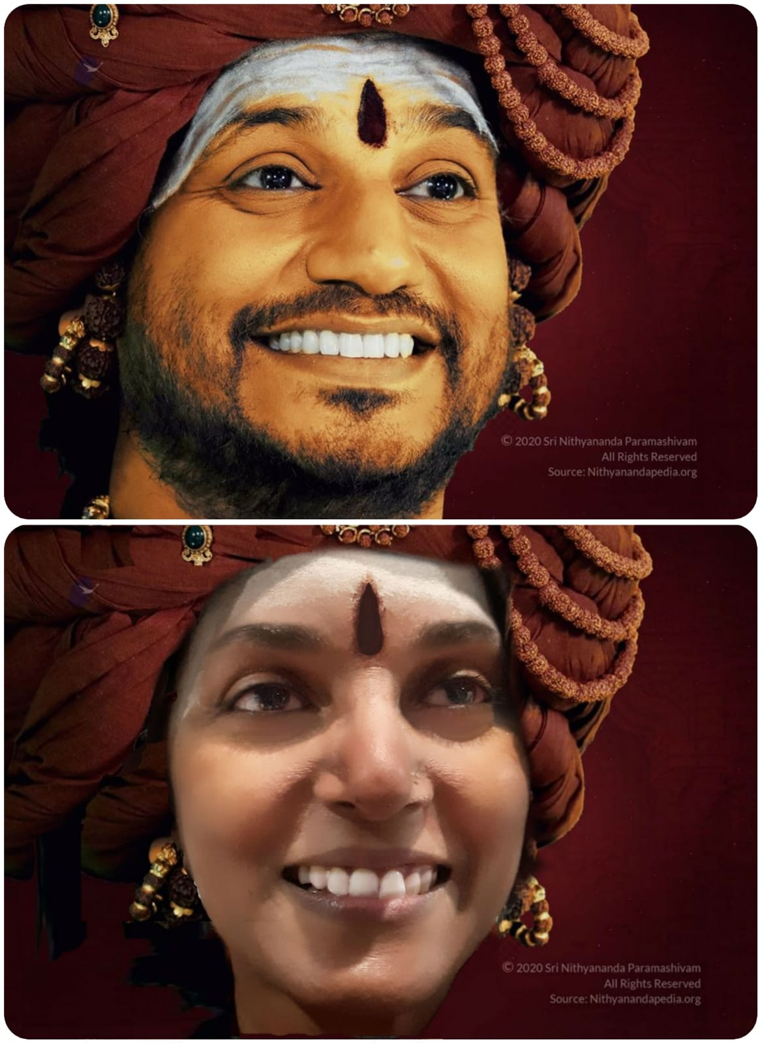
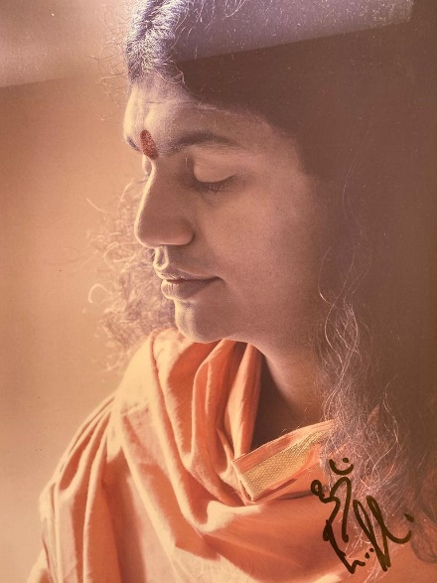
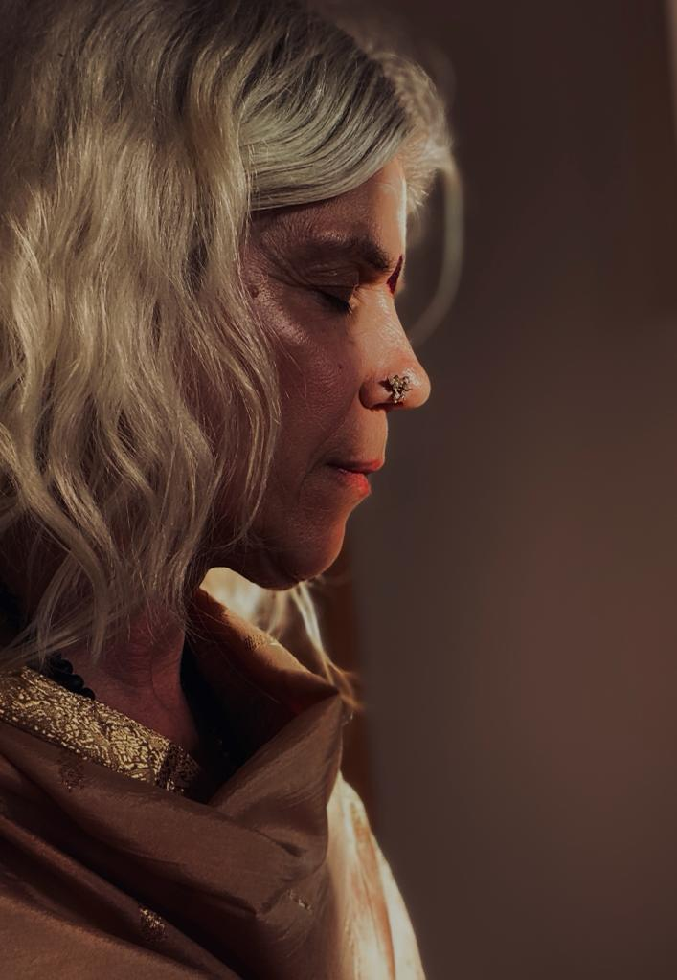
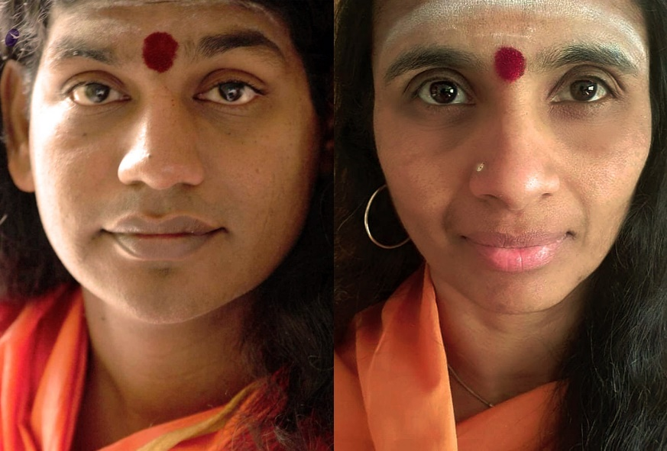
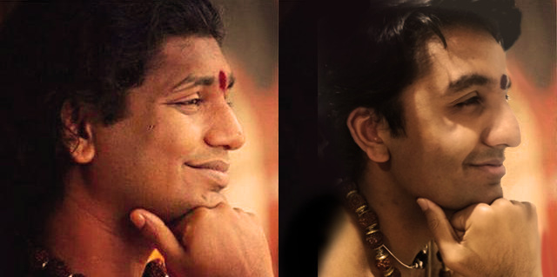
#IAmNithyananda

